Slide 1
Misinformation Protection in Communication Networks
Lorand Ladnai, Mihael Stoyanov, Dimitar Kochev, Matei Pop

Slide 2
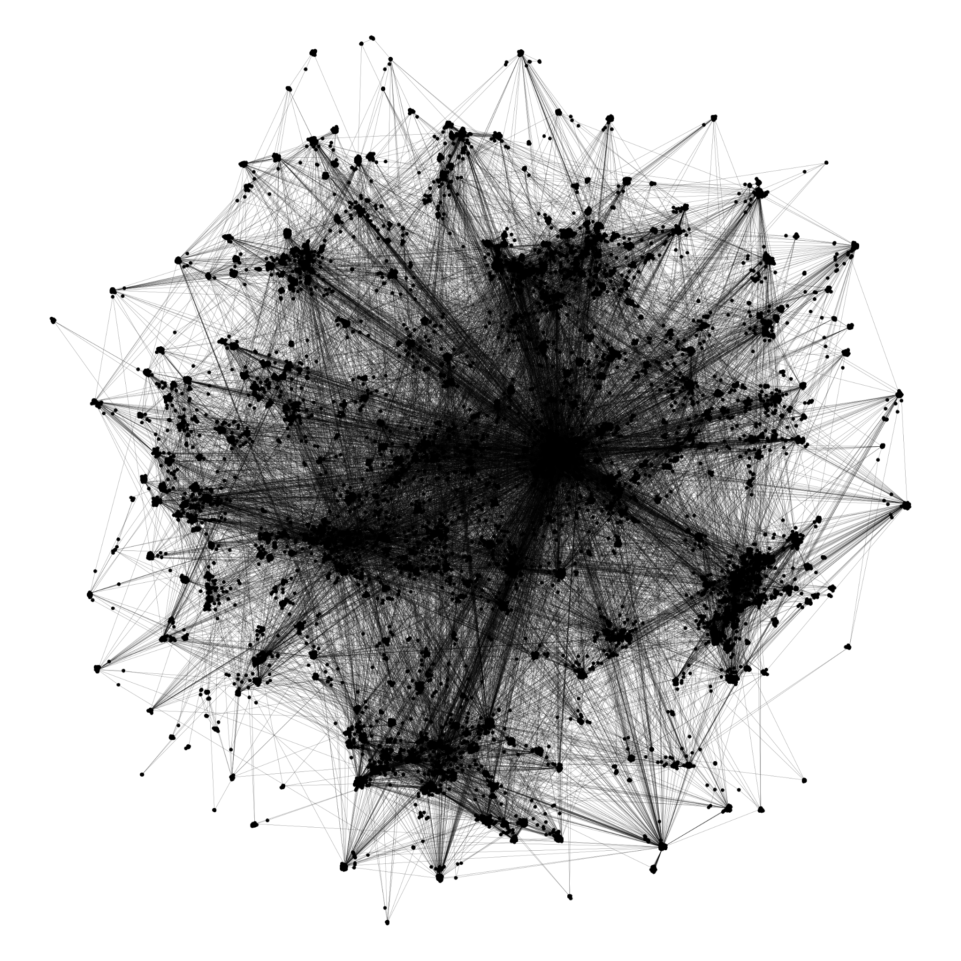
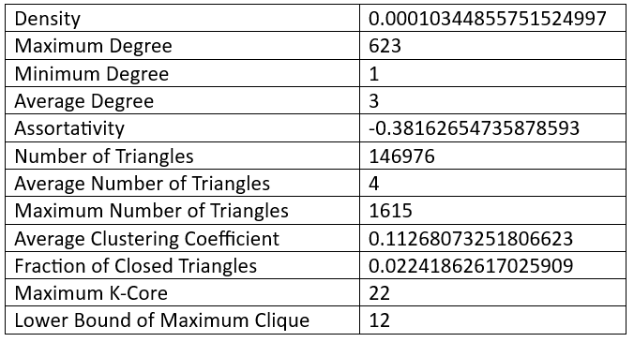
Original network
sparse
undirected
unweighted

Slide 3
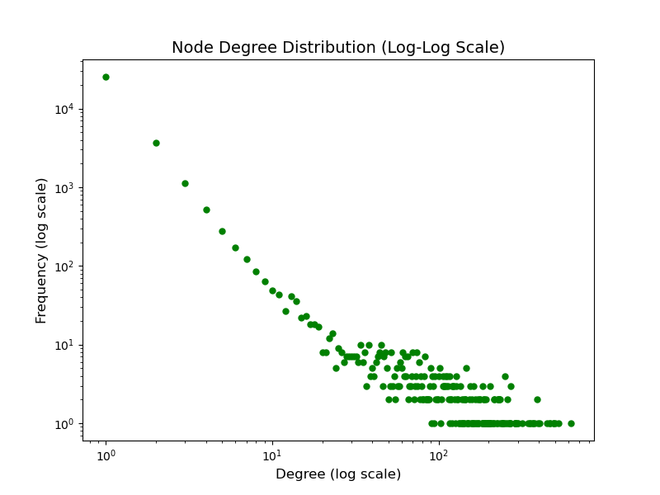
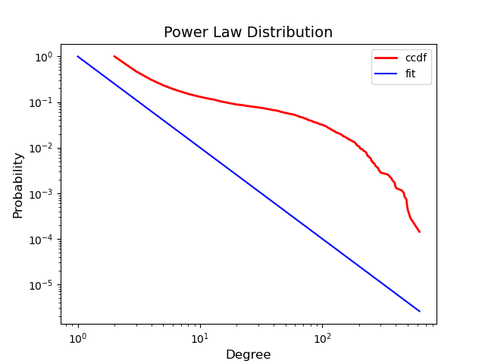
Degree Distribution
It does not satisfy the power law conditions!

Slide 4
Research Question
What is the significance of protecting high-degree nodes in misinformation spread?
What is the spread behavior in our network?
How do we want to define the spread simulations?
How can we evaluate the results?

Slide 5
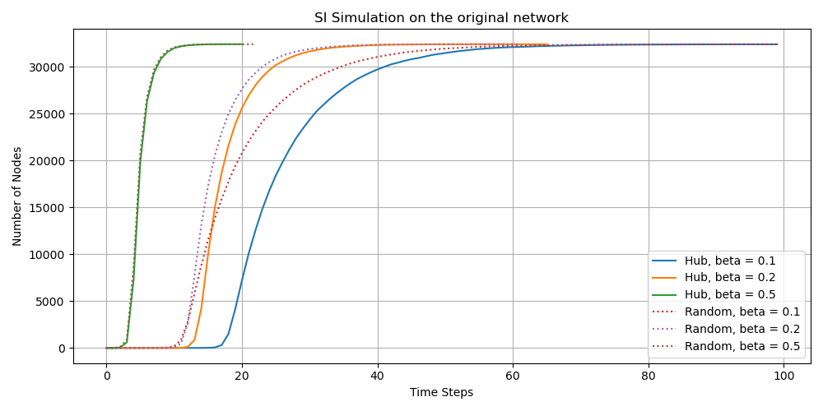
SI model on the original network
Simulated with β=0.1,0.2,0.5
Starting points:
randomly selected node
a highly connected node (degree = 623)

Slide 6
SIR model
Infection probability - 0.5
Initial recovery - 23% (average among EU countries)
Recovery probability - 1
Threshold for immunization - 3% of all nodes are infected
Two starting points – a random node and a highly connected node

Slide 7
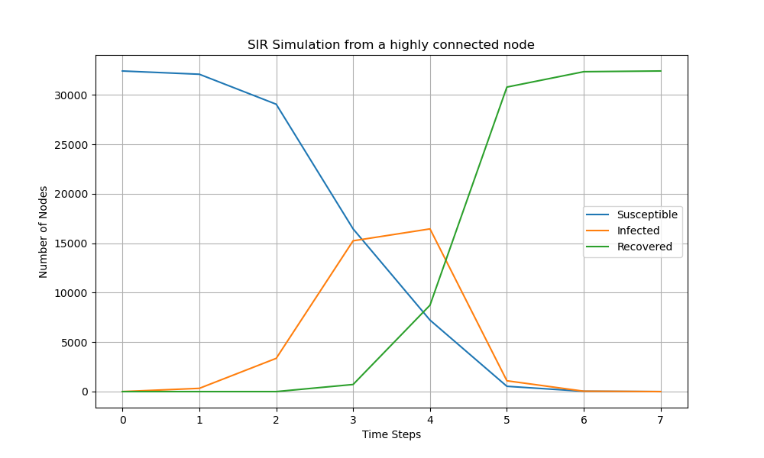
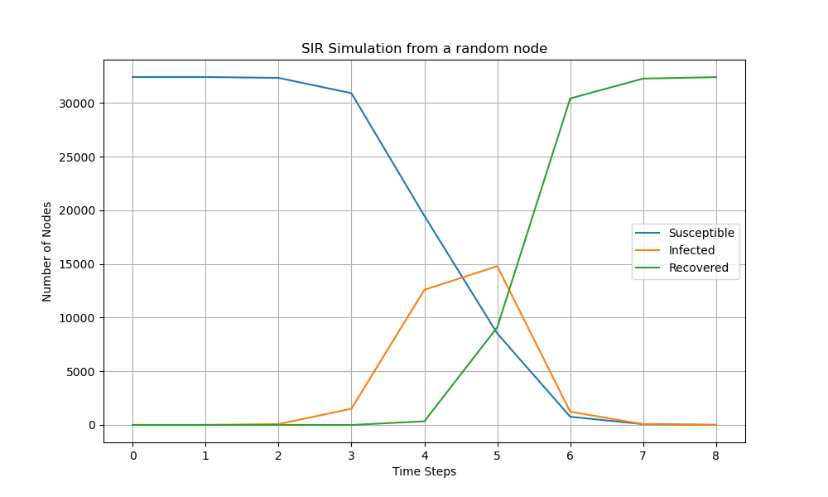
SIR model on the original network
Infection peak: 0.55
Time steps: 7
Infection peak: 0.47
Time steps: 8

Slide 8
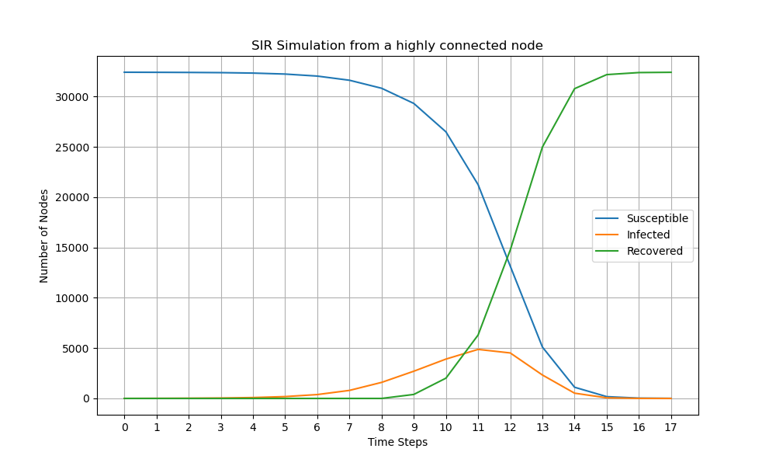
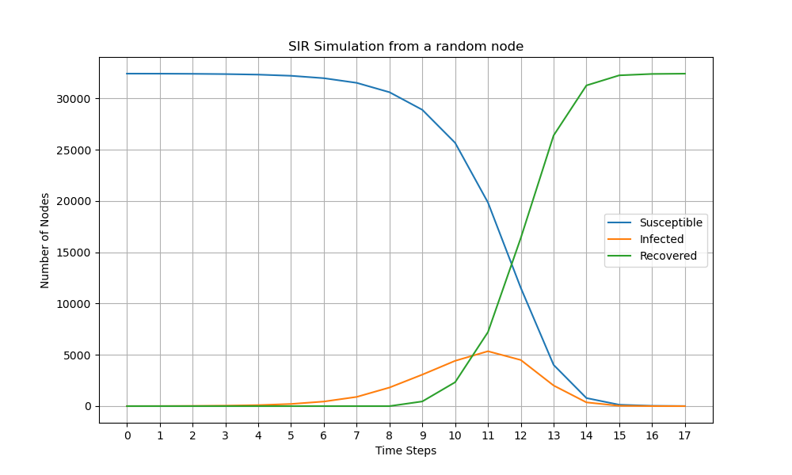
SIR model on the synthetic network
Infection peak: 0.16
Time steps: 17
Infection peak: 0.18
Time steps: 17

Slide 9
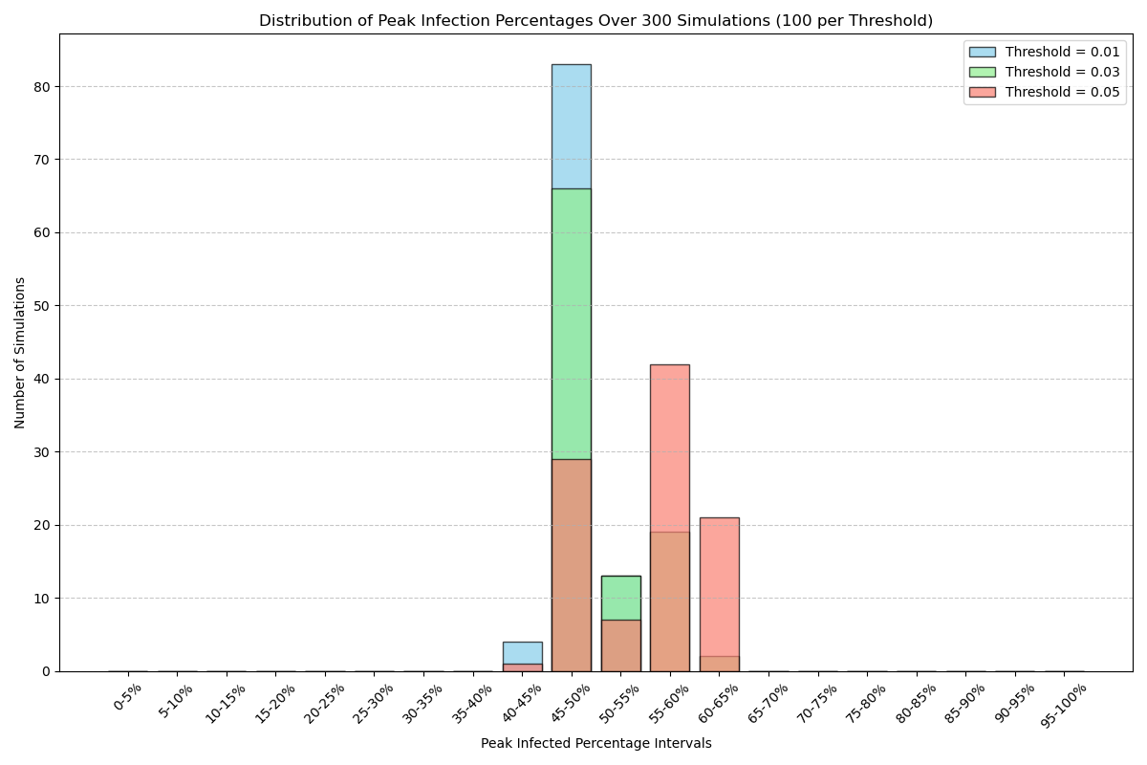
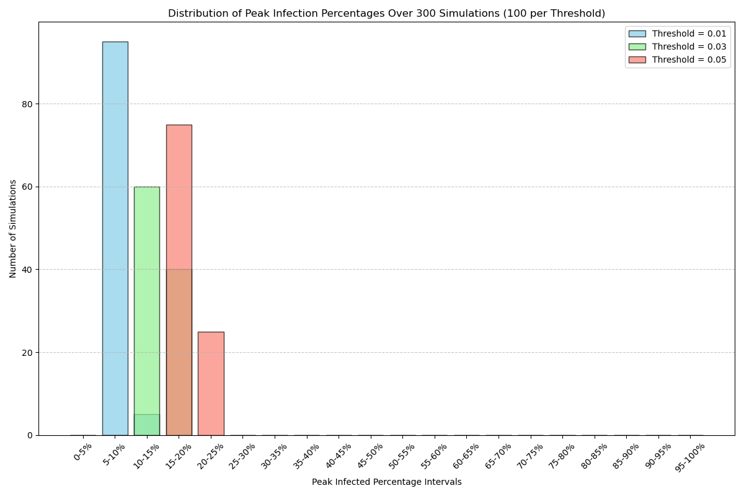
Distribution of Peak Infection percentages
ORIGINAL NETWORK
SYNTHETIC NETWORK

Slide 10
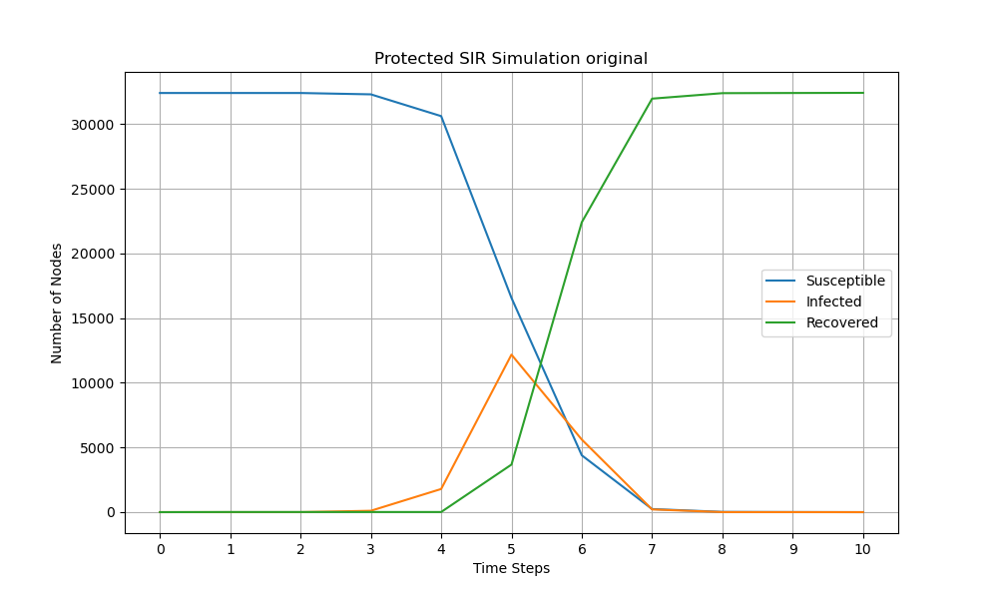
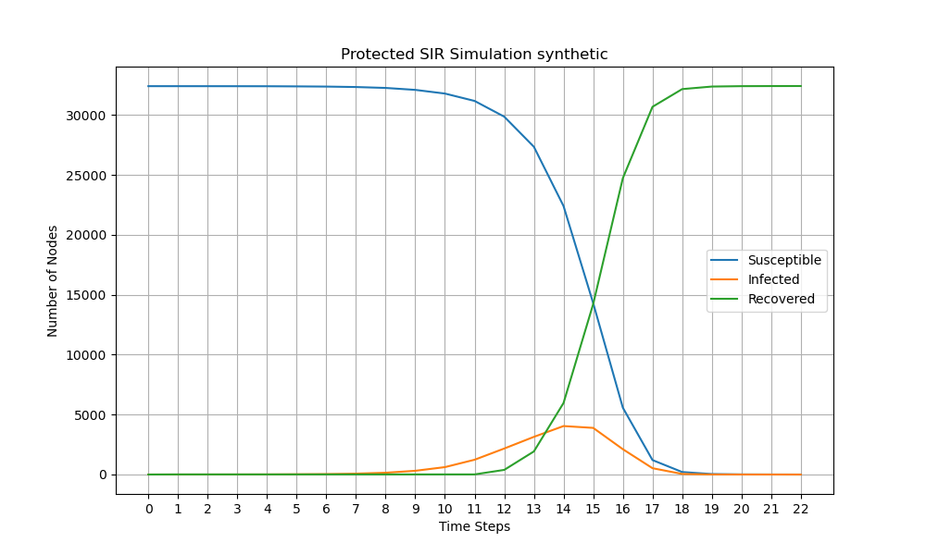
What if we protect the high-degree nodes
Infection peak: 0.40
Time steps: 10
Infection peak: 0.13
Time step: 22

Slide 11
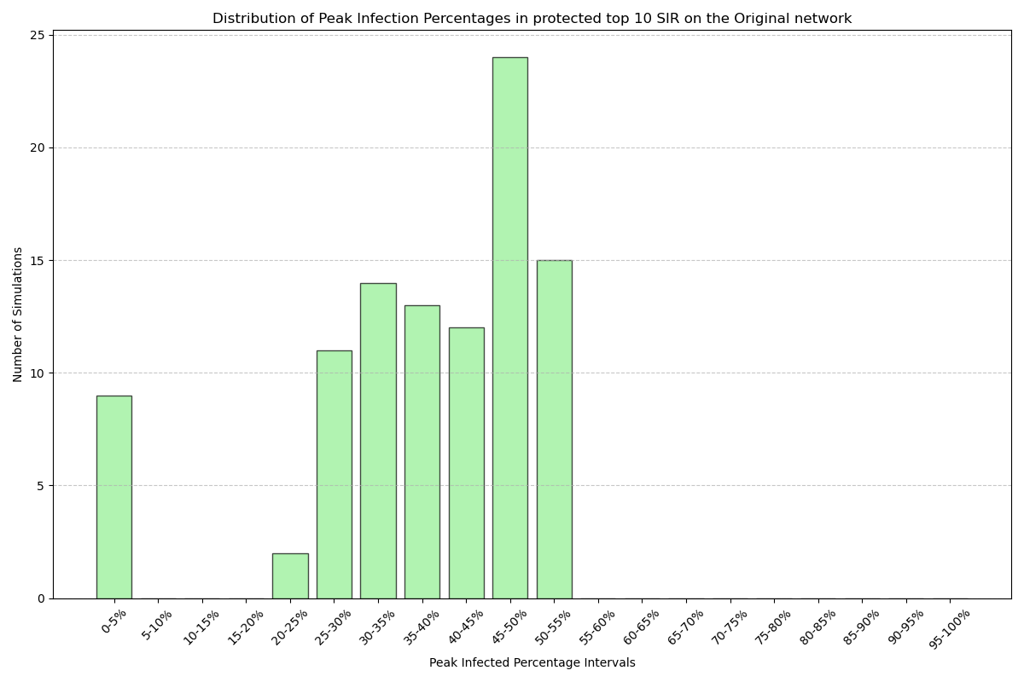
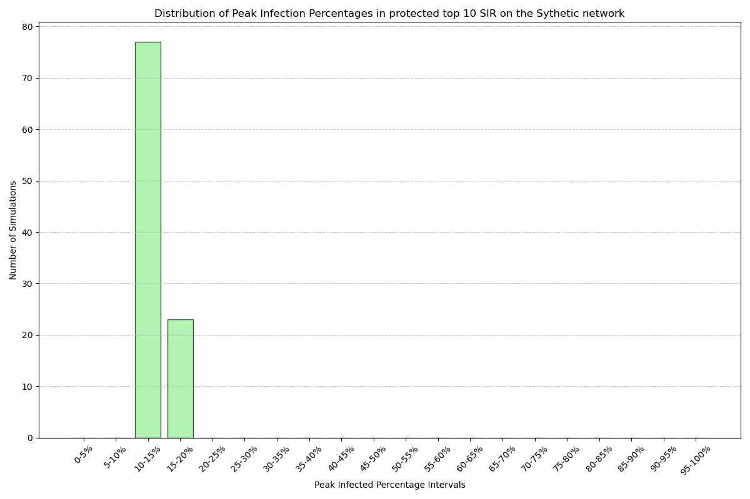
Distribution among simulations
ORIGINAL NETWORK
SYNTHETIC NETWORK

Slide 12
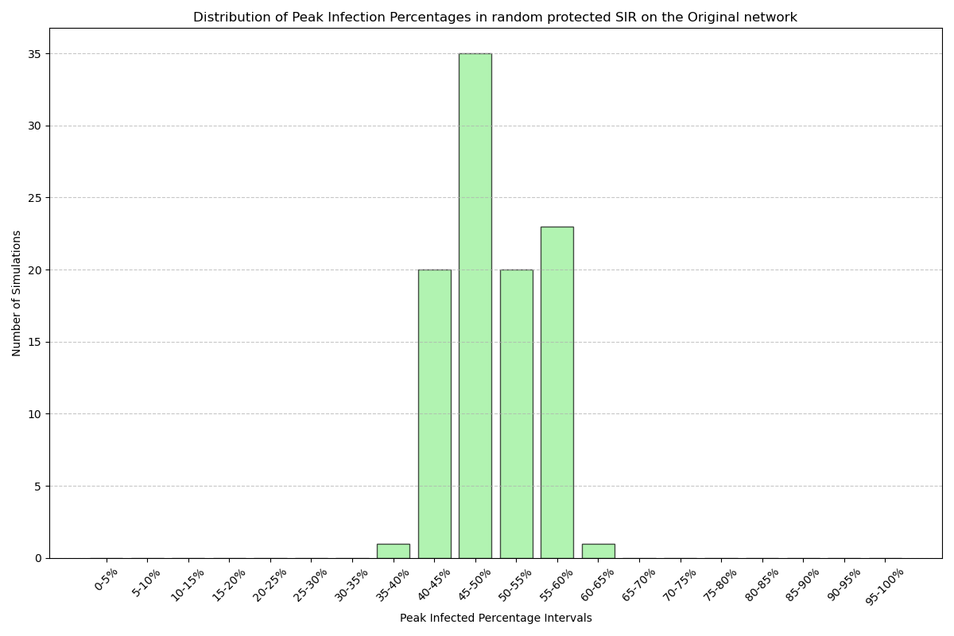
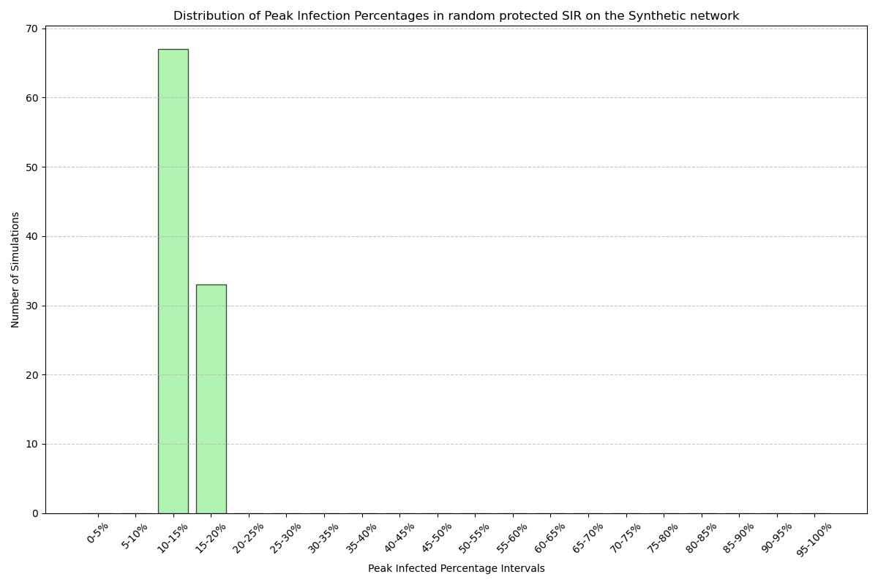
Random protection
Lower protection performance on both networks.
Similar number of time steps for the synthetic network
Simulations on the original are significantly shorter

Slide 13
Conclusion
Original Network
Avg. peak infection No protection |  | Infection Rate
 |  | 1% | 3% | 5%
Recovery Rate | 0.1 | 0,206 | 0.340 | 0.523
 | 0.2 | 0.320 | 0.430 | 0.554
 | 0.5 | 0.582 | 0.637 | 0.688
Avg. peak infection Random protection |  | Infection Rate
 |  | 1% | 3% | 5%
Recovery Rate | 0.1 | 0.207 | 0.341 | 0.521
 | 0.2 | 0.321 | 0.428 | 0.555
 | 0.5 | 0.580 | 0.638 | 0.688
Avg. peak infection Top 10 |  | Infection Rate
 |  | 1% | 3% | 5%
Recovery Rate | 0.1 | 0.159 | 0.309 | 0.480
 | 0.2 | 0.253 | 0.356 | 0.504
 | 0.5 | 0.470 | 0.525 | 0.583
Avg. timesteps No protection |  | Infection Rate
 |  | 1% | 3% | 5%
Recovery Rate | 0.1 | 19.691 | 21.551 | 24.716
 | 0.2 | 14.516 | 15.524 | 16.786
 | 0.5 | 10.942 | 11.311 | 11.908
Avg. timesteps Random protection |  | Infection Rate
 |  | 1% | 3% | 5%
Recovery Rate | 0.1 | 20.339 | 21.834 | 25.188
 | 0.2 | 14.395 | 15.465 | 16.630
 | 0.5 | 10.909 | 11.485 | 11.901
Avg. timesteps Top 10 |  | Infection Rate
 |  | 1% | 3% | 5%
Recovery Rate | 0.1 | 21.972 | 23.897 | 26.662
 | 0.2 | 16.978 | 17.260 | 19.319
 | 0.5 | 13.689 | 13.698 | 14.070

Slide 14
Conclusion
Synthetic Network
Avg. peak infection No protection |  | Infection Rate
 |  | 1% | 3% | 5%
Recovery Rate | 0.1 | 0.096 | 0.229 | 0.288
 | 0.2 | 0.131 | 0.342 | 0.545
 | 0.5 | 0.266 | 0.491 | 0.639
Avg. peak infection Random protection |  | Infection Rate
 |  | 1% | 3% | 5%
Recovery Rate | 0.1 | 0.096 | 0.228 | 0.271
 | 0.2 | 0.131 | 0.343 | 0.543
 | 0.5 | 0.266 | 0.493 | 0.637
Avg. peak infection Top 10 |  | Infection Rate
 |  | 1% | 3% | 5%
Recovery Rate | 0.1 | 0.096 | 0.225 | 0.266
 | 0.2 | 0.130 | 0.342 | 0.542
 | 0.5 | 0.262 | 0.488 | 0.634
Avg. timesteps No protection |  | Infection Rate
 |  | 1% | 3% | 5%
Recovery Rate | 0.1 | 49.392 | 50.934 | 51.000
 | 0.2 | 32.895 | 36.205 | 38.239
 | 0.5 | 21.308 | 22.426 | 23.165
Avg. timesteps Random protection |  | Infection Rate
 |  | 1% | 3% | 5%
Recovery Rate | 0.1 | 49.223 | 50.881 | 50.997
 | 0.2 | 32.582 | 35.852 | 38.004
 | 0.5 | 21.252 | 22.123 | 22.786
Avg. timesteps Top 10 |  | Infection Rate
 |  | 1% | 3% | 5%
Recovery Rate | 0.1 | 49.259 | 50.911 | 51.000
 | 0.2 | 32.772 | 35.849 | 38.053
 | 0.5 | 21.229 | 22.155 | 22.671

Slide 15
Further discussion and possible alternative methods
Pagerank
Betweenness centrality
SEIR model
Possible real-life use of our results:
Rural remote areas with restricted internet access
Military or security networks

Slide 16
Limitations
The original network structure: the central node's high degree makes it critical for network connectivity. Its removal would lead to the isolation of many nodes.
Time for comparison with more naturally occurring social networks or generated networks.

Slide 17
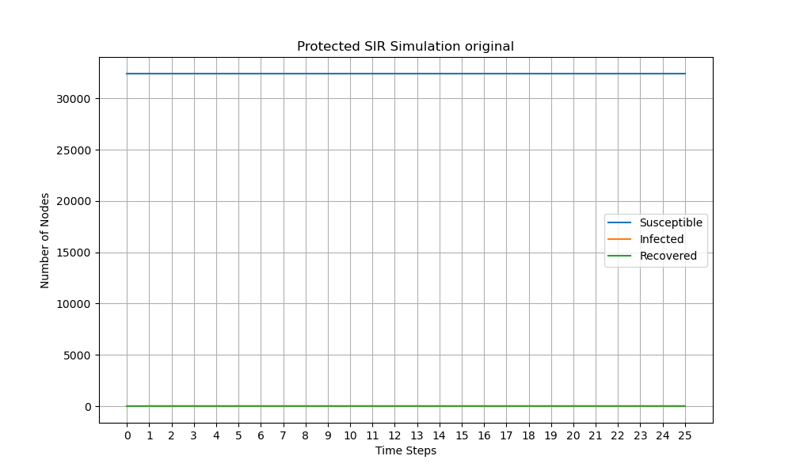
Extras

Slide 18
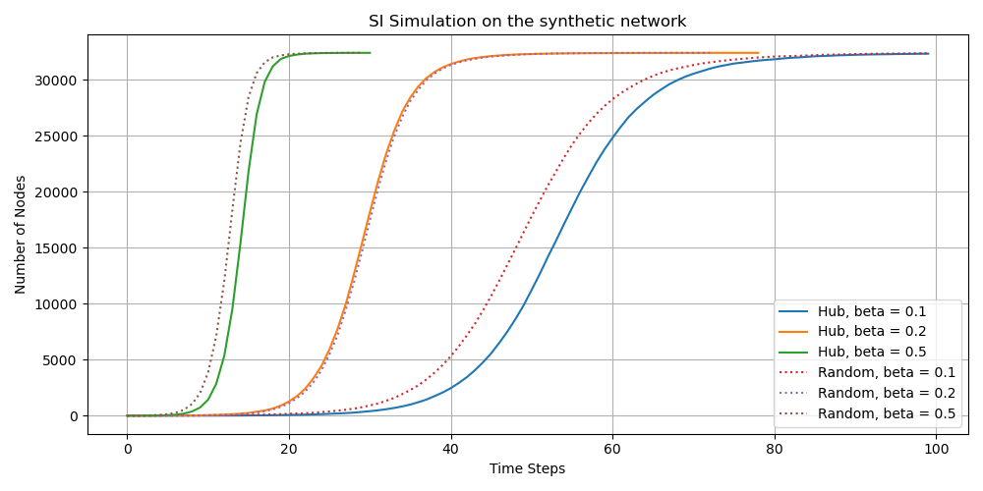
SI model on the synthetic network

